Slide 1
Linux Kernel
Lecture 5: Storage Devices & Linux File Systems

Slide 2
A Multi-Platter Disk

Slide 3
Types of Delay With Disks
Long delay
Three types of delay
Rotational Delay
Time to rotate the desired sector to the read head
Related to RPM
Seek delay
Time to move the read head to a different track
Transfer time
Time to read or write bytes
Rotation
11
12
13
10
23
24
25
14
32
9
22
31
33
26
15
8
21
30
34
27
0
7
20
29
35
16
1
28
6
19
17
2
18
5
4
3
Track skew: offset sectors so that sequential reads across tracks incorporate seek delay
Short delay

Slide 4

How To Calculate Transfer Time
Transfer time
T_{I/O} = T_{seek} + T_{rotation} + T_{transfer}
Assume we are transferring 4096 bytes
 | Cheetah 15K.5 | Barracuda
Capacity | 300 GB | 1 TB
RPM | 15000 | 7200
Avg. Seek | 4 ms | 9 ms
Max Transfer | 125 MB/s | 105 MB/s
T_{I/O} = 4 ms + 1 / (15000 RPM / 60 s/M / 1000 ms/s) / 2
+ (4096 B / 125 MB/s * 1000 ms/s / 2²⁰ MB/B)
T_{I/O} = 4 ms + 2ms + 0.03125 ms ≈ 6 ms
Cheetah
T_{I/O} = 9 ms + 1 / (7200 RPM / 60 s/M / 1000 ms/s) / 2
+ (4096 B / 105 MB/s * 1000 ms/s / 2²⁰ MB/B)
T_{I/O} = 9 ms + 4.17 ms + 0.0372 ms ≈ 13.2 ms
Barracuda

Slide 5
Sequential vs. Random Access
Rate of I/O
R_{I/O} = transfer_size / T_{I/O}
Access Type | Transfer Size |  | Cheetah 15K.5 | Barracuda
Random | 4096 B | T_{I/O} | 6 ms | 13.2 ms
 |  | R_{I/O} | 0.66 MB/s | 0.31 MB/s
Sequential | 100 MB | T_{I/O} | 800 ms | 950 ms
 |  | R_{I/O} | 125 MB/s | 105 MB/s
Max Transfer Rate |  |  | 125 MB/s | 105MB/s
Random I/O results in very poor disk performance!

Slide 6
Caching
Many disks incorporate caches (track buffer)
Small amount of RAM (8, 16, or 32 MB)
Read caching
Reduces read delays due to seeking and rotation
Write caching
Write back cache: drive reports that writes are complete after they have been cached
Possibly dangerous feature. Why?
Write through cache: drive reports that writes are complete after they have been written to disk
Today, some disks include flash memory for persistent caching (hybrid drives)

Slide 7
Disk Scheduling
Caching helps improve disk performance
But it can’t make up for poor random access times
Key idea: if there are a queue of requests to the disk, they can be reordered to improve performance
First come, first serve (FCFC)
Shortest seek time first (SSTF)
SCAN, otherwise know as the elevator algorithm
C-SCAN, C-LOOK, etc.

Slide 8
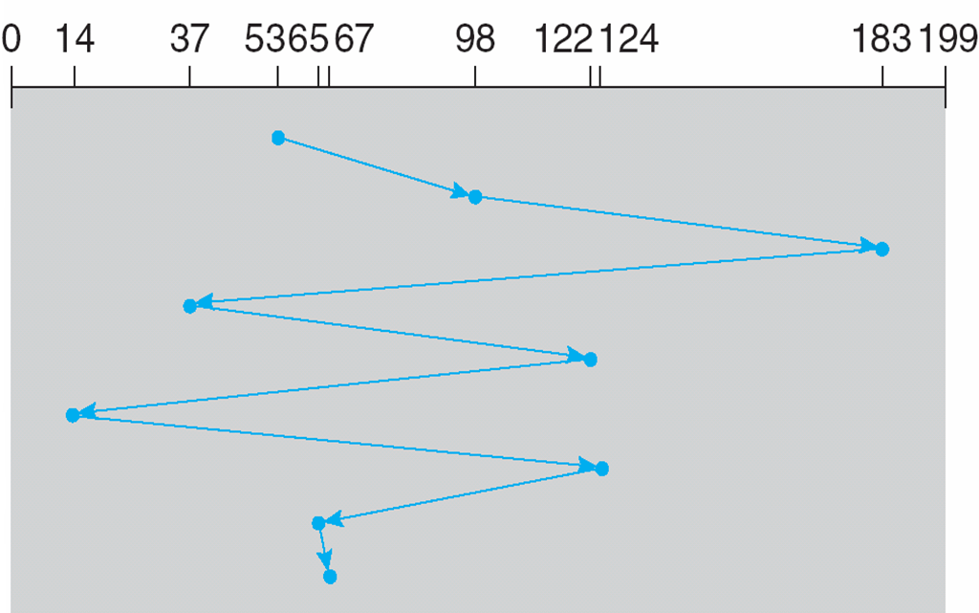
FCFS Scheduling
Most basic scheduler, serve requests in order
Head starts at block 53
Queue: 98, 183, 37, 122, 14, 124, 65, 67
Lot’s of time spent seeking
Total movement: 640 cylinders

Slide 9
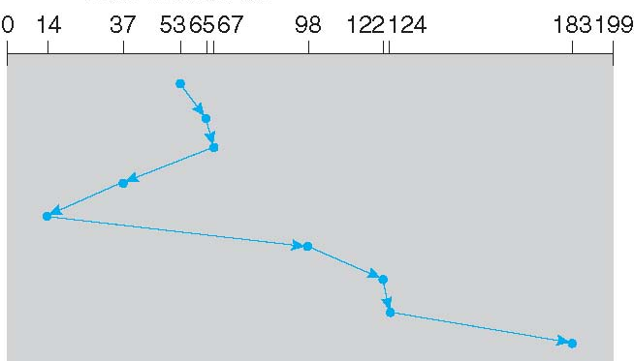
SSTF Scheduling
Idea: minimize seek time by always selecting the block with the shortest seek time
Head starts at block 53
Queue: 98, 183, 37, 122, 14, 124, 65, 67
The good: SSTF is optimal, and it can be easily implemented!
The bad: SSTF is prone to starvation
Total movement: 236 cylinders

Slide 10
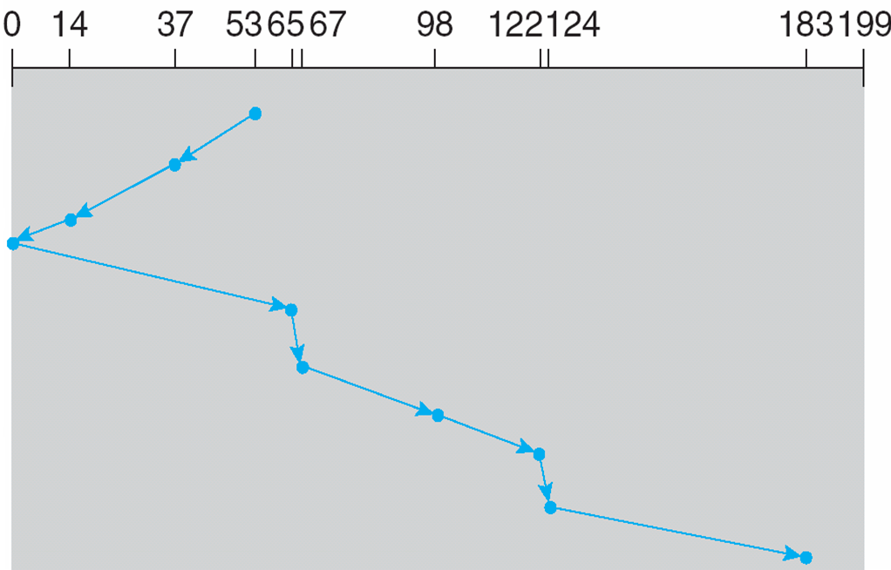
SCAN Example
Head sweeps across the disk servicing requests in order
Head starts at block 53
Queue: 98, 183, 37, 122, 14, 124, 65, 67
The good: reasonable performance, no starvation
The bad: average access times are less for requests at high and low addresses
Total movement: 236 cylinders

Slide 11
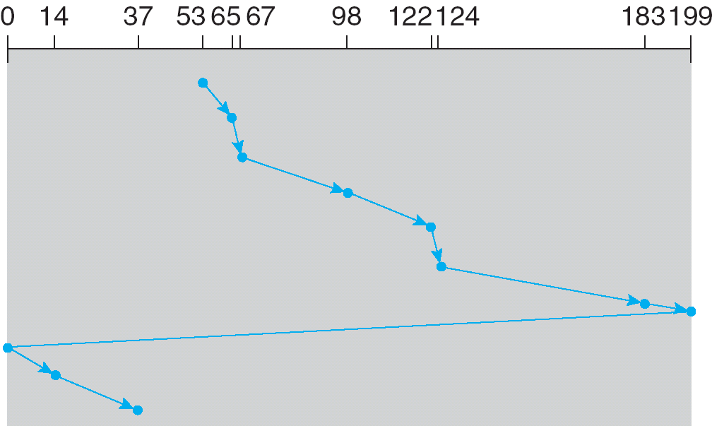
C-SCAN Example
Like SCAN, but only service requests in one direction
Head starts at block 53
Queue: 98, 183, 37, 122, 14, 124, 65, 67
The good: fairer than SCAN
The bad: worse performance than SCAN
Total movement: 382 cylinders

Slide 12
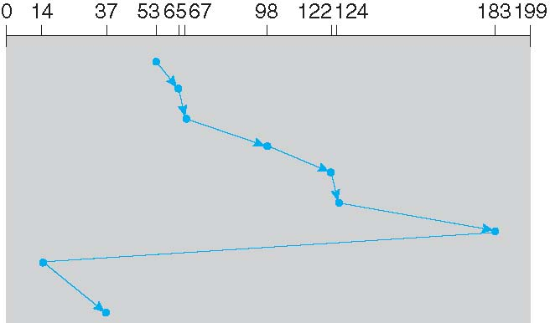
C-LOOK Example
Peek at the upcoming addresses in the queue
Head only goes as far as the last request
Head starts at block 53
Queue: 98, 183, 37, 122, 14, 124, 65, 67
Total movement: 322 cylinders

Slide 13
Implementing Disk Scheduling
We have talked about several scheduling problems that take place in the kernel
Process scheduling
Page swapping
Where should disk scheduling be implemented?
OS scheduling
OS can implement SSTF or LOOK by ordering the queue by LBA
However, the OS cannot account for rotation delay
On-disk scheduling
Disk knows the exact position of the head and platters
Can implement more advanced schedulers (SPTF)
But, requires specialized hardware and drivers

Slide 14
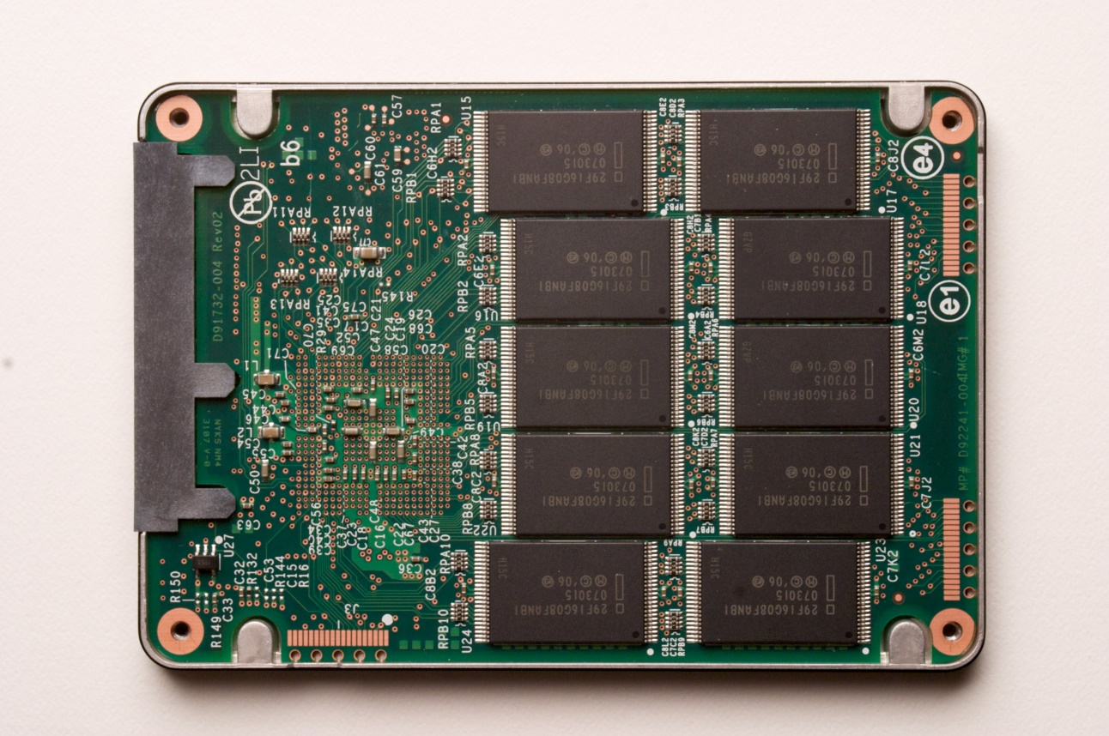
Solid State Drives
NAND flash memory-based drives
High voltage is able to change the configuration of a floating-gate transistor
State of the transistor interpreted as binary data
Data is striped across all chips
Flash memory chip

Slide 15
Advantages of SSDs
More resilient against physical damage
No sensitive read head or moving parts
Immune to changes in temperature
Greatly reduced power consumption
No mechanical, moving parts
Much faster than hard drives
>500 MB/s vs ~200 MB/s for hard drives
No penalty for random access
Each flash cell can be addressed directly
No need to rotate or seek
Extremely high throughput
Although each flash chip is slow, they are RAIDed

Slide 16
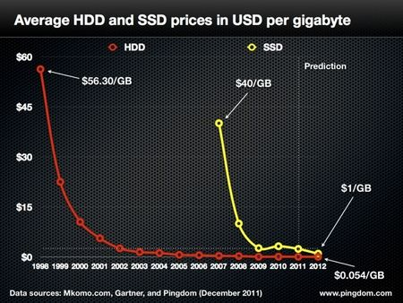

Slide 17
Challenges with Flash
Flash memory is written in pages, but erased in blocks
Pages: 4 – 16 KB, Blocks: 128 – 256 KB
Thus, flash memory can become fragmented
Leads to the write amplification problem
Flash memory can only be written a fixed number of times
Typically 3000 – 5000 cycles for MLC
SSDs use wear leveling to evenly distribute writes across all flash cells

Slide 18
Write Amplification
G moved to new block by the garbage collector
Cleaned block can now be rewritten
Block X
Block Y
Stale pages cannot be overwritten or erased individually
A
G
C’’
K
D
G
C’
F’
F’’
J
B
A’
A’’
L
E
D’
D’’
H
A’’’
C
F
B’
E’
B’’
E’’
I
B’’’
Once all pages have been written, valid pages must be consolidated to free up space
Write amplification: a write triggers garbage collection/compaction
One or more blocks must be read, erased, and rewritten before the write can proceed

Slide 19
Garbage Collection
Garbage collection (GC) is vital for the performance of SSDs
Older SSDs had fast writes up until all pages were written once
Even if the drive has lots of “free space,” each write is amplified, thus reducing performance
Many SSDs over-provision to help the GC
240 GB SSDs actually have 256 GB of memory
Modern SSDs implement background GC
However, this doesn’t always work correctly

Slide 20
The Ambiguity of Delete
Goal: the SSD wants to perform background GC
But this assumes the SSD knows which pages are invalid
Problem: most file systems don’t actually delete data
On Linux, the “delete” function is unlink()
Removes the file meta-data, but not the file itself

Slide 21
Delete Example
Block X
File metadata (inode, name, etc.)
Metadata is overwritten, but the file remains
Meta
File
File
Meta
Meta
File
File
Meta
File
File
File
File is written to SSD
File is deleted
The GC executes
9 pages look valid to the SSD
The OS knows only 2 pages are valid
Lack of explicit delete means the GC wastes effort copying useless pages
Hard drives are not GCed, so this was never a problem

Slide 22
Designing the File System: Access Patterns
How do users access files?
Need to know type of access patterns user is likely to throw at system
Sequential Access: bytes read in order (“give me the next X bytes, then give me next, etc”)
Almost all file access are of this flavor
Random Access: read/write element out of middle of array (“give me bytes i—j”)
Less frequent, but still important. For example, virtual memory backing file: page of memory stored in file
Want this to be fast – don’t want to have to read all bytes to get to the middle of the file
Content-based Access: (“find me 100 bytes starting with uestc-ccse”)
Example: employee records – once you find the bytes, increase my salary by a factor of 2
Many systems don’t provide this; instead, databases are built on top of disk access to index content (requires efficient random access)

Slide 23
Designing the File System: Usage Patterns
Most files are small (for example, .login, .c files)
A few files are big – nachos, core files, etc.; the nachos executable is as big as all of your .class files combined
However, most files are small – .class’s, .o’s, .c’s, etc.
Large files use up most of the disk space and bandwidth to/from disk
May seem contradictory, but a few enormous files are equivalent to an immense # of small files
Although we will use these observations, beware usage patterns:
Good idea to look at usage patterns: beat competitors by optimizing for frequent patterns
Except: changes in performance or cost can alter usage patterns. Maybe UNIX has lots of small files because big files are really inefficient?

Slide 24
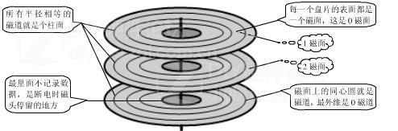
文件数据组织与管理
分区
分区
分区
磁盘
文件系统
柱面组0
柱面组1
…
柱面组n
自举块
超级块
超级块
副本
配置
信息
i节点
图
块
位图
i节点表
数据块
i节点
i节点
i节点
……
i节点
24
从硬件层角度思考：多个不同的文件系统如何在磁盘中共存？
Notes:
从硬件的角度思考

Slide 25
How do we actually access files?
All information about a file contained in its file header
UNIX calls this an “inode”
Inodes are global resources identified by index (“inumber”)
Once you load the header structure, all the other blocks of the file are locatable
Question: how does the user ask for a particular file?
One option: user specifies an inode by a number (index).
Imagine: open(“14553344”)
Better option: specify by textual name
Have to map name→inumber
Another option: Icon
Graphical user interfaces. Point to a file and click.
Naming: The process by which a system translates from user-visible names to system resources
In the case of files, need to translate from strings (textual names) or icons to inumbers/inodes
For global file systems, data may be spread over globe⇒need to translate from strings or icons to some combination of physical server location and inumber

Slide 26
Directories
Directory: a relation used for naming
Just a table of (file name, inumber) pairs
How are directories constructed?
Directories often stored in files
Reuse of existing mechanism
Directory named by inode/inumber like other files
Needs to be quickly searchable
Options: Simple list or Hashtable
Can be cached into memory in easier form to search
How are directories modified?
Originally, direct read/write of special file
System calls for manipulation: mkdir, rmdir
Ties to file creation/destruction
Directories organized into a hierarchical structure
Entries in directory can be either files or directories
Files named by “path” through directory structure: e.g. /usr/homes/george/data.txt

Slide 27
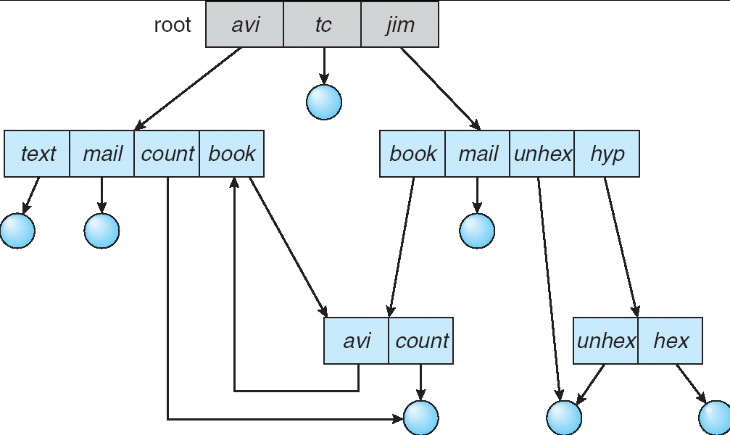
Directory Structure
Not really a hierarchy!
Many systems allow directory structure to be organized as an acyclic graph or even a (potentially) cyclic graph
Hard Links: different names for the same file
Multiple directory entries point at the same file
Soft Links: “shortcut” pointers to other files
Implemented by storing the logical name of actual file
Name Resolution: The process of converting a logical name into a physical resource (like a file)
Traverse succession of directories until reach target file
Global file system: May be spread across the network

Slide 28
Directory Structure (Con’t)
How many disk accesses to resolve “/my/book/count”?
Read in file header for root (fixed spot on disk)
Read in first data block for root
Table of file name/index pairs. Search linearly – ok since directories typically very small
Read in file header for “my”
Read in first data block for “my”; search for “book”
Read in file header for “book”
Read in first data block for “book”; search for “count”
Read in file header for “count”
Current working directory: Per-address-space pointer to a directory (inode) used for resolving file names
Allows user to specify relative filename instead of absolute path (say CWD=“/my/book” can resolve “count”)

Slide 29
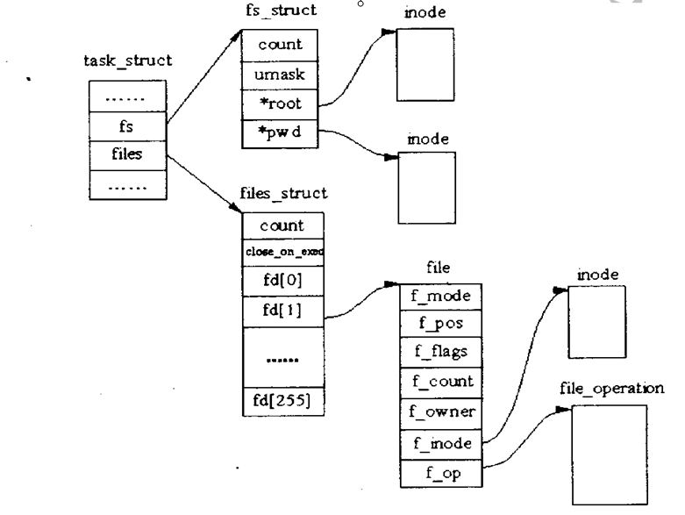
In-Memory File System Structures

Slide 30
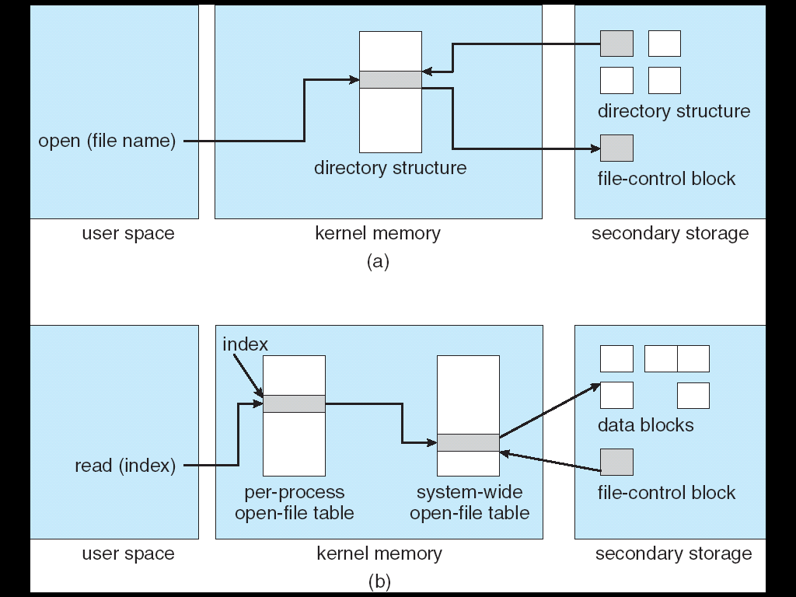
In-Memory File System Structures
Open system call:
Resolves file name, finds file control block (inode)
Makes entries in per-process and system-wide tables
Returns index (called “file handle”) in open-file table
Read/write system calls:
Use file handle to locate inode
Perform appropriate reads or writes

Slide 31
File System Caching
Key Idea: Exploit locality by caching data in memory
Name translations: Mapping from paths→inodes
Disk blocks: Mapping from block address→disk content
Buffer Cache: Memory used to cache kernel resources, including disk blocks and name translations
Can contain “dirty” blocks (blocks yet on disk)
Replacement policy? LRU
Can afford overhead of timestamps for each disk block
Advantages:
Works very well for name translation
Works well in general as long as memory is big enough to accommodate a host’s working set of files.
Disadvantages:
Fails when some application scans through file system, thereby flushing the cache with data used only once
Example: find . –exec grep foo {} \;
Other Replacement Policies?
Some systems allow applications to request other policies
Example, ‘Use Once’:
File system can discard blocks as soon as they are used

Slide 32
File System Caching (con’t)
Cache Size: How much memory should the OS allocate to the buffer cache vs virtual memory?
Too much memory to the file system cache ⇒ won’t be able to run many applications at once
Too little memory to file system cache ⇒ many applications may run slowly (disk caching not effective)
Solution: adjust boundary dynamically so that the disk access rates for paging and file access are balanced
Read Ahead Prefetching: fetch sequential blocks early
Key Idea: exploit fact that most common file access is sequential by prefetching subsequent disk blocks ahead of current read request (if they are not already in memory)
Elevator algorithm can efficiently interleave groups of prefetches from concurrent applications
How much to prefetch?
Too many imposes delays on requests by other applications
Too few causes many seeks (and rotational delays) among concurrent file requests

Slide 33
File System Caching (con’t)
Delayed Writes: Writes to files not immediately sent out to disk
Instead, write() copies data from user space buffer to kernel buffer (in cache)
Enabled by presence of buffer cache: can leave written file blocks in cache for a while
If some other application tries to read data before written to disk, file system will read from cache
Flushed to disk periodically (e.g. in UNIX, every 30 sec)
Advantages:
Disk scheduler can efficiently order lots of requests
Disk allocation algorithm can be run with correct size value for a file
Some files need never get written to disk! (e..g temporary scratch files written /tmp often don’t exist for 30 sec)
Disadvantages
What if system crashes before file has been written out?
Worse yet, what if system crashes before a directory file has been written out? (lose pointer to inode!)

Slide 34
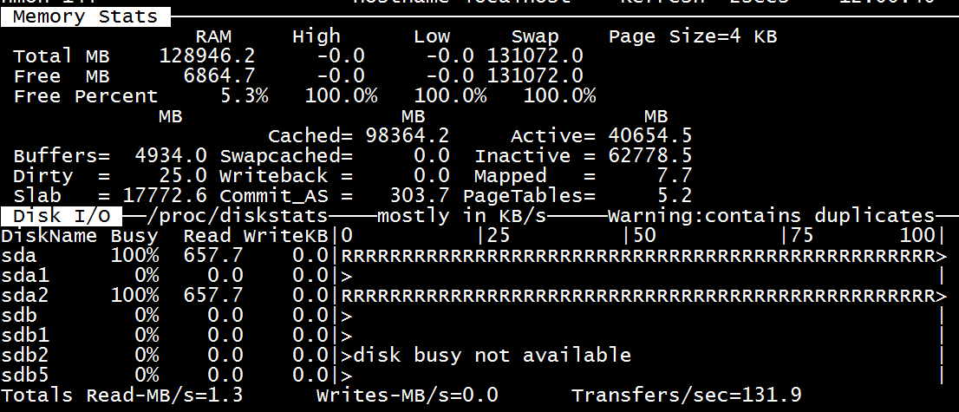
The Linux Page Cache
Goal: Minimize disk I/O by storing data in memory
Caches any page-based objects, including files and memory mappings

Slide 35
How to make file system durable?
Disk blocks contain Reed-Solomon error correcting codes (ECC) to deal with small defects in disk drive
Can allow recovery of data from small media defects
Make sure writes survive in short term
Either abandon delayed writes or
use special, battery-backed RAM (called non-volatile RAM or NVRAM) for dirty blocks in buffer cache.
Make sure that data survives in long term
Need to replicate! More than one copy of data!
Important element: independence of failure
Could put copies on one disk, but if disk head fails…
Could put copies on different disks, but if server fails…
Could put copies on different servers, but if building is struck by lightning….
Could put copies on servers in different continents…
RAID: Redundant Arrays of Inexpensive Disks
Data stored on multiple disks (redundancy)
Either in software or hardware
In hardware case, done by disk controller; file system may not even know that there is more than one disk in use

Slide 36
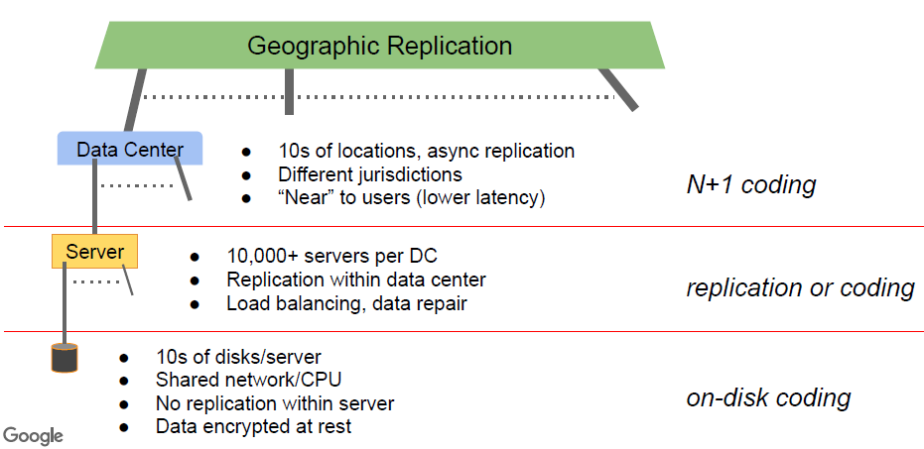
File Storage in Google
FAST2016 , Feb,2016,CA

Slide 37
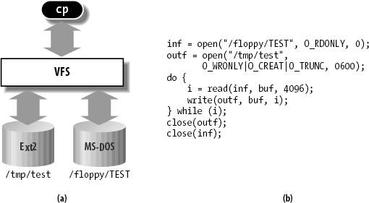
Virtual Filesystem Switch (VFS)
VFS: Virtual abstraction similar to local file system
Provides virtual superblocks, inodes, files, etc
Compatible with a variety of local and remote file systems
provides object-oriented way of implementing file systems
VFS allows the same system call interface (the API) to be used for different types of file systems
The API is to the VFS interface, rather than any specific type of file system

Slide 38
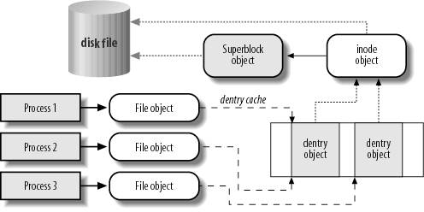
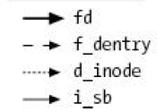
VFS Common File Model
Four primary object types for VFS:
superblock object: represents a specific mounted filesystem
inode object: represents a specific file
dentry object: represents a directory entry
file object: represents open file associated with process
There is no specific directory object (VFS treats directories as files)
May need to fit the model by faking it
Example: make it look like directories are files
Example: make it look like have inodes, superblocks, etc.

Slide 39
Linux VFS
write()
sys_write()
filesystem’s
write method
physical
media
user-space
VFS
filesystem
An operations object is contained within each primary object type to set operations of specific filesystems
“super_operations”: methods that kernel can invoke on a specific filesystem, i.e. write_inode() and sync_fs().
“inode_operations”: methods that kernel can invoke on a specific file, such as create() and link()
“dentry_operations”: methods that kernel can invoke on a specific directory entry, such as d_compare() or d_delete()
“file_operations”: methods that process can invoke on an open file, such as read() and write()

Slide 40
File System Types
lots and lots of filesystem types!
2.6 has nearly 100 in the standard kernel tree
examples
standard: Ext2, ufs (Solaris), svfs (SysV), ffs (BSD)
network: RFS, NFS, Andrew, Coda, Samba, Novell
journaling: Ext3, Veritas, ReiserFS, XFS, JFS
media-specific: jffs, ISO9660 (cd), UDF (dvd)
special: /proc, tmpfs, sockfs, etc.
proprietary
MSDOS, VFAT, NTFS, Mac, Amiga, etc.
new generation for Linux
Ext3, ReiserFS, XFS, JFS

Slide 41
Linux File System Model
basically UNIX file semantics
File systems are mounted at various points
Files identified by device inode numbers
VFS layer just dispatches to fs-specific functions
libc read() -> sys_read()
what type of filesystem does this file belong to?
call filesystem (fs) specific read function
maintained in open file object (file)
example: file->f_op->read(…)
similar to device abstraction model in UNIX

Slide 42
VFS System Calls
fundamental UNIX abstractions
files (everything is a file)
ex: /dev/ttyS0 – device as a file
ex: /proc/123 – process as a file
processes
users
lots of syscalls related to files! (~100)
most dispatch to filesystem-specific calls
some require no filesystem action
example: lseek(pos) – change position in file
others have default VFS implementations

Slide 43
VFS System Calls (cont.)
filesystem ops – mounting, info, flushing, chroot, pivot_root
directory ops – chdir, getcwd, link, unlink, rename, symlink
file ops – open/close, (p)read(v)/(p)write(v), seek, truncate, dup fcntl, creat,
inode ops – stat, permissions, chmod, chown
memory mapping files – mmap, munmap, madvise, mlock
wait for input – poll, select
flushing – sync, fsync, msync, fdatasync
file locking – flock

Slide 44
VFS-related Task Fields
task_struct fields
fs – includes root, pwd
pointers to dentries
files – includes file descriptor array fd[]
pointers to open file objects

Slide 45
Big Four Data Structures
struct file
information about an open file
includes current position (file pointer)
struct dentry
information about a directory entry
includes name + inode#
struct inode
unique descriptor of a file or directory
contains permissions, timestamps, block map (data)
inode#: integer (unique per mounted filesystem)
struct superblock
descriptor of a mounted filesystem

Slide 46
Two More Data Structures
struct file_system_type
name of file system
pointer to implementing module
including how to read a superblock
On module load, you call register_file_system and pass a pointer to this structure
struct vfsmount
Represents a mounted instance of a particular file system
One super block can be mounted in two places, with different covering sub mounts
Thus lookup requires parent dentry and a vfsmount

Slide 47
Data Structure Relationships
task_struct
inode cache
inode
inode
inode
fds
open
file
object
open
file
object
superblock
dentry
dentry
open
file
object
dentry
disk
dentry
dentry
dentry cache

Slide 48
Sharing Data Structures
calling dup() –
shares open file objects
example: 2>&1
opening the same file twice –
shares dentries
opening same file via different hard links –
shares inodes
mounting same filesystem on different dirs –
shares superblocks

Slide 49
Superblock
mounted filesystem descriptor
usually first block on disk (after boot block)
copied into (similar) memory structure on mount
distinction: disk superblock vs memory superblock
dirty bit (s_dirt), copied to disk frequently
important fields
s_dev, s_bdev – device, device-driver
s_blocksize, s_maxbytes, s_type
s_flags, s_magic, s_count, s_root, s_dquot
s_dirty – dirty inodes for this filesystem
s_op – superblock operations
u – filesystem specific data

Slide 50
Superblock Operations
filesystem-specific operations
read/write/clear/delete inode
write_super, put_super (release)
no get_super()! that lives in file_system_type descriptor
write_super_lockfs, unlockfs, statfs
file_handle ops (NFS-related)
show_options

Slide 51
Inode
"index" node – unique file or directory descriptor
meta-data: permissions, owner, timestamps, size, link count
data: pointers to disk blocks containing actual data
data pointers are "indices" into file contents (hence "inode")
inode # - unique integer (per-mounted filesystem)
what about names and paths?
high-level fluff on top of a "flat-filesystem"
implemented by directory files (directories)
directory contents: name + inode

Slide 52
File Links
UNIX link semantics
hard links – multiple dir entries with same inode #
equal status; first is not "real" entry
file deleted when link count goes to 0
restrictions
can't hard link to directories (avoids cycles)
or across filesystems
soft (symbolic) links – little files with pathnames
just aliases for another pathname
no restrictions, cycles possible, dangling links possible

Slide 53
Inode Fields
large struct (~50 fields)
important fields
i_sb, i_ino (number), i_nlink (link count)
metadata: i_mode, i_uid, i_gid, i_size, i_times
i_flock (lock list), i_wait (waitq – for blocking ops)
linkage: i_hash, i_list, i_dentry (aliases)
i_op (inode ops), i_fop (default file ops)
u (filesystem specific data – includes block map!)

Slide 54
Inode Operations
create – new inode for regular file
link/unlink/rename –
add/remove/modify dir entry
symlink, readlink, follow_link – soft link ops
mkdir/rmdir – new inode for directory file
mknod – new inode for device file
truncate – modify file size
permission – check access permissions

Slide 55
(Open) File Object
struct file (usual variable name - filp)
association between file and process
no disk representation
created for each open (multiple possible, even same file)
most important info: file pointer
file descriptor (small ints)
index into array of pointers to open file objects
file object states
unused (memory cache + root reserve (10))
get_empty_filp()
inuse (per-superblock lists)
system-wide max on open file objects (~8K)
/proc/sys/fs/file-max

Slide 56
File Object Fields
important fields
f_dentry (directory entry of file)
f_vfsmnt (fs mount point)
f_op (fs-specific functions – table of function pointers)
f_count, f_flags, f_mode (r/w, permissions, etc.)
f_pos (current position – file pointer)
info for read-ahead (more later)
f_uid, f_gid, f_owner
f_version (for consistency maintenance)
private_data (fs-specific data)

Slide 57
File Object Operations
f_op field – table of function pointers
copied from inode (i_fop) initially (fs-specific)
possible to change to customize (per-open)
device-drivers do some tricks like this sometimes
important operations
llseek(), read(), write(), readdir(), poll()
ioctl() – "wildcard" function for per-fs semantics
mmap(), open(), flush(), release(), fsync()
fasync() – turn on/off asynchronous i/o notifications
lock() – file-locks (more later)
readv(), writev() – "scatter/gather i/o"
read/write with discontiguous buffers (e.g. packets)
sendpage() – page-optimized socket transfer

Slide 58
Dentry
abstraction of directory entry
ex: line from ls -l
either files (hard links) or soft links or subdirectories
every dentry has a parent dentry (except root)
sibling dentries – other entries in the same directory
directory api: dentry iterators
posix: opendir(), readdir(), scandir(), seekdir(), rewinddir()
syscall: getdents()
why an abstraction?
UNIX: directories are really files with directory "records"
MSDOS, etc.: directory is just a big table on disk (FAT)
no such thing as subdirectories!
just fields in table (file->parentdir), (dir->parentdir)

Slide 59
Dentry (continued)
not-disk based (no dirty bit)
dentry_cache – slab cache
important fields
d_name (qstr), d_count, d_flags
d_inode – associated inode
d_parent – parent dentry
d_child – siblings list
d_subdirs – my children (if i'm a subdirectory)
d_alias – other names (links) for the same object (inode)?
d_lru – unused state linkage
d_op – dentry operations (function pointer table)
d_fsdata – filesystem-specific data

Slide 60
Dentry Cache
very important cache for filesystem performance
every file access causes multiple dentry accesses!
example: /tmp/foo
dentries for "/", "/tmp", "/tmp/foo" (path components)
dentry cache "controls" inode cache
inodes released only when dentry is released
dentry cache accessed via hash table
hash(dir, filename) -> dentry

Slide 61
Dentry Cache (continued)
dentry states
free (not valid; maintained by slab cache)
in-use (associated with valid open inode)
unused (valid but not being used; LRU list)
negative (file that does not exist)
dentry ops
just a few, mostly default actions
ex: d_compare(dir, name1, name2)
case-insensitive for MSDOS

Slide 62
Process-related Files
current->fs (fs_struct)
root (for chroot jails)
pwd
umask (default file permissions)
current->files (files_struct)
fd[] (file descriptor array – pointers to file objects)
0, 1, 2 – stdin, stdout, stderr
originally 32, growable to 1,024 (RLIMIT_NOFILE)
complex structure for growing … see book
close_on_exec memory (bitmap)
open files normally inherited across exec

Slide 63
Filesystem Types
Linux must "know about" filesystem before mount
multiple (mounted) instances of each type possible
special (virtual) filesystems (like /proc)
structuring technique to touch kernel data
examples:
/proc, /dev (devfs)
sockfs, pipefs, tmpfs, rootfs, shmfs
associated with fictitious block device (major# 0)
minor# distinguishes special filesystem types

Slide 64
Registering a Filesystem Type
must register before mount
static (compile-time) or dynamic (modules)
register_filesystem() / unregister_filesystem
adds file_system_type object to linked-list
file_systems (head; kernel global variable)
file_systems_lock (rw spinlock to protect list)
file_system_type descriptor
name, flags, pointer to implementing module
list of superblocks (mounted instances)
read_super() – pointer to method for reading superblock
most important thing! filesystem specific

Slide 65
Data Structure Relationships (2)
open
file
object
dentry
f_dentry
d_subdirs
d_inode
d_subdirs
d_parent
i_sb
d_sb
i_dentries
open
file
object
dentry
dentry
dentry
inode
inode
inode
┴
open
file
object
superblock

Slide 66
Ext2
“Standard” Linux File System
Previously it was the most commonly used
Serves as a basis for Ext3 which adds journaling
Uses FFS like layout
Each file system is composed of identical block groups
Allocation is designed to improve locality
Inodes contain pointers (32 bits) to blocks
Direct, Indirect, Double Indirect, Triple Indirect
Maximum file size: 4.1TB (4K Blocks)
Maximum file system size: 16TB (4K Blocks)

Slide 67
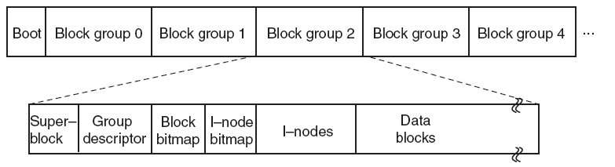
Ext2 Disk Layout
Files in the same directory are stored in the same block group
Files in different directories are spread among the block groups
Picture from Tanenbaum, Modern Operating Systems 3 e, (c) 2008 Prentice-Hall, Inc. All rights reserved. 0-13-6006639

Slide 68
Block Addressing in Ext2
Inode
Twelve “direct” blocks
Data
Block
Data
Block
Data
Block
BLKSIZE/4
Indirect
Blocks
Data
Block
Data
Block
Data
Block
Indirect
Blocks
Data
Block
(BLKSIZE/4)²
Data
Block
Data
Block
Double
Indirect
Indirect
Blocks
Data
Block
Data
Block
Data
Block
(BLKSIZE/4)³
Data
Block
Data
Block
Indirect
Blocks
Data
Block
Triple
Indirect
Double
Indirect
Data
Block
Indirect
Blocks
Data
Block
Data
Block
Picture from Tanenbaum, Modern Operating Systems 3 e, (c) 2008 Prentice-Hall, Inc. All rights reserved. 0-13-6006639

Slide 69
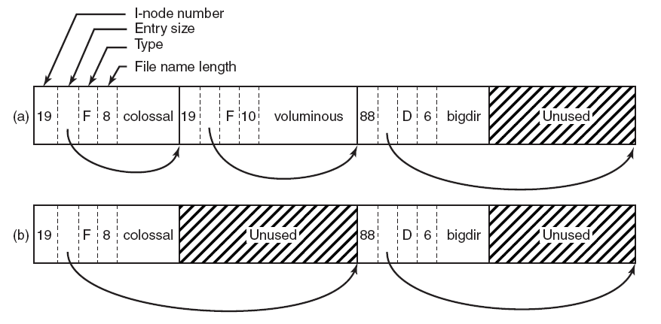
Ext2 Directory Structure
(a) A Linux directory with three files. (b) The same directory after the file voluminous has been removed.
Picture from Tanenbaum, Modern Operating Systems 3 e, (c) 2008 Prentice-Hall, Inc. All rights reserved. 0-13-6006639

Slide 70
Building the Root File System
One of the first tasks of an OS during bootup is to build the root file system
Locate all bootable media
Internal and external hard disks
SSDs
Floppy disks, CDs, DVDs, USB sticks
Locate all the partitions on each media
Read MBR(s), extended partition tables, etc.
Mount one or more partitions
Makes the file system(s) available for access

Slide 71
The Master Boot Record
Address |  | Description | Size (Bytes)
Hex | Dec.
0x000 | 0 | Bootstrap code area | 446
0x1BE | 446 | Partition Entry #1 | 16
0x1CE | 462 | Partition Entry #2 | 16
0x1DE | 478 | Partition Entry #3 | 16
0x1EE | 494 | Partition Entry #4 | 16
0x1FE | 510 | Magic Number | 2
 |  | Total: | 512
Includes the starting LBA and length of the partition
MBR
Partition 1
(ext3)
Partition 2
(swap)
Partition 3
(NTFS)
Partition 4
(FAT32)
Disk 1
MBR
Partition 1
(NTFS)
Disk 2

Slide 72
Extended Partitions
In some cases, you may want >4 partitions
Modern OSes support extended partitions
MBR
Partition 1
(ext3)
Partition 2
(swap)
Partition 3
(Extended Partition)
Ext. Part.
Logical Partition 1
(NTFS)
Logical Partition 2
(NTFS)
Partition 4
(FAT32)
Disk 1
Extended partitions may use OS-specific partition table formats (meta-data)
Thus, other OSes may not be able to read the logical partitions

Slide 73
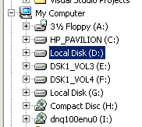
Types of Root File Systems
Windows exposes a multi-rooted system
Each device and partition is assigned a letter
Internally, a single root is maintained
Linux has a single root
One partition is mounted as /
All other partitions are mounted somewhere under /
Typically, the partition containing the kernel is mounted as / or C:
[cbw@ativ9 ~] df -h
Filesystem Size Used Avail Use% Mounted on
/dev/sda7 39G 14G 23G 38% /
/dev/sda2 296M 48M 249M 16% /boot/efi
/dev/sda5 127G 86G 42G 68% /media/cbw/Data
/dev/sda4 61G 34G 27G 57% /media/cbw/Windows
/dev/sdb1 1.9G 352K 1.9G 1% /media/cbw/NDSS-2013
1 drive, 4 partitions
1drive, 1 partition

Slide 74
Mounting a File System
Read the super block for the target file system
Contains meta-data about the file system
Version, size, locations of key structures on disk, etc.
Determine the mount point
On Windows: pick a drive letter
On Linux: mount the new file system under a specific directory
Filesystem Size Used Avail Use% Mounted on
/dev/sda5 127G 86G 42G 68% /media/cbw/Data
/dev/sda4 61G 34G 27G 57% /media/cbw/Windows
/dev/sdb1 1.9G 352K 1.9G 1% /media/cbw/NDSS-2013

Slide 75
Virtual File System Interface
Problem: the OS may mount several partitions containing different underlying file systems
It would be bad if processes had to use different APIs for different file systems
Linux uses a Virtual File System interface (VFS)
Exposes POSIX APIs to processes
Forwards requests to lower-level file system specific drivers
Windows uses a similar system

Slide 76


VFS Flowchart
Processes (usually) don’t need to know about low-level file system details
Relatively simple to add additional file system drivers
Process 1
Process 2
Process 3
Kernel
Virtual File System Interface
ext3 Driver
NTFS Driver
FAT32 Driver
ext3 Partition
NTFS Partition
FAT32 Partition

Slide 77

Mount isn’t Just for Bootup
When you plug storage devices into your running system, mount is executed in the background
Example: plugging in a USB stick
What does it mean to “safely eject” a device?
Flush cached writes to that device
Cleanly unmount the file system on that device

Slide 78
Partitions and Mounting
Basics (FAT)
inodes and Blocks (ext)
Block Groups (ext2)
Journaling (ext3)
Extents and B-Trees (ext4)
Log-based File Systems

Slide 79
Status Check
At this point, the OS can locate and mount partitions
Next step: what is the on-disk layout of the file system?
We expect certain features from a file system
Named files
Nested hierarchy of directories
Meta-data like creation time, file permissions, etc.
How do we design on-disk structures that support these features?

Slide 80





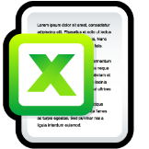





The Directory Tree
cs5600
home
cbw
bin
/ (root)
python
tmp
amislove
Navigated using a path
E.g. /home/amislove/music.mp3

Slide 81
Absolute and Relative Paths
Two types of file system paths
Absolute
Full path from the root to the object
Example: /home/cbw/cs5600/hw4.pdf
Example: C:\Users\cbw\Documents\
Relative
OS keeps track of the working directory for each process
Path relative to the current working directory
Examples [working directory = /home/cbw]:
syllabus.docx [ → /home/cbw/syllabus.docx]
cs5600/hw4.pdf [ → /home/cbw/cs5600/hw4.pdf]
./cs5600/hw4.pdf [ → /home/cbw/cs5600/hw4.pdf]
../amislove/music.mp3 [ → /home/amislove/music.mp3]

Slide 82




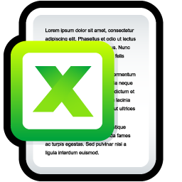






Files
A file is a composed of two components
The file data itself
One or more blocks (sectors) of binary data
A file can contain anything
Meta-data about the file
Name, total size
What directory is it in?
Created time, modified time, access time
Hidden or system file?
Owner and owner’s group
Permissions: read/write/execute

Slide 83
File Extensions
File name are often written in dotted notation
E.g. program.exe, image.jpg, music.mp3
A file’s extension does not mean anything
Any file (regardless of its contents) can be given any name or extension
Has the data in the file changed from music to an image?
Rename
Graphical shells (like Windows explorer) use extensions to try and match files → programs
This mapping may fail for a variety of reasons

Slide 84
More File Meta-Data
Files have additional meta-data that is not typically shown to users
Unique identifier (file names may not be unique)
Structure that maps the file to blocks on the disk
Managing the mapping from files to blocks is one of the key jobs of the file system
Disk

Slide 85



Mapping Files to Blocks
Every file is composed of >=1 blocks
Key question: how do we map a file to its blocks?
List of blocks
As (start, length) pairs
[1]
[4, 5, 7, 8]
[6]
(1, 1)
(4, 4)
(9, 1)
0
1
2
3
4
5
6
7
8
9
0
1
2
3
4
5
6
7
8
9
Problem?
Really large files
Problem?
Fragmentation
E.g. try to add a new file with 3 blocks

Slide 86
Directories
Traditionally, file systems have used a hierarchical, tree-structured namespace
Directories are objects that contain other objects
i.e. a directory may (or may not) have children
Files are leaves in the tree
By default, directories contain at least two entries
“..” points the the parents directory
“.” self pointer
.
..
/ (root)
bin
python

Slide 87



More on Directories
Directories have associated meta-data
Name, number of entries
Created time, modified time, access time
Permissions (read/write), owner, and group
The file system must encode directories and store them on the disk
Typically, directories are stored as a special type of file
File contains a list of entries inside the directory, plus some meta-data for each entry

Slide 88


Example Directory File
Windows
C:\
Name | Index | Dir? | Perms
. | 2 | Y | rwx
Windows | 3 | Y | rwx
Users | 4 | Y | rwx
pagefile.sys | 5 | N | r
Users
pagefile.sys
0
1
2
3
4
5
6
7
8
9
Disk
C:\

Slide 89
Directory File Implementation
Each directory file stores many entries
Key Question: how do you encode the entries?
Other alternatives: hash tables, B-trees
More on B-trees later…
In practice, implementing directory files is complicated
Example: do filenames have a fixed, maximum length or variable length?
Unordered List of Entries
Sorted List of Entries
Name | Index | Dir? | Perms
. | 2 | Y | rwx
Windows | 3 | Y | rwx
Users | 4 | Y | rwx
pagefile.sys | 5 | N | r
Name | Index | Dir? | Perms
. | 2 | Y | rwx
pagefile.sys | 5 | N | r
Users | 4 | Y | rwx
Windows | 3 | Y | rwx
Good: O(1) to add new entries
Just append to the file
Bad: O(n) to search for an entry
Good: O(log n) to search for an entry
Bad: O(n) to add new entries
Entire file has the be rewritten

Slide 90
Partitions and Mounting
inodes and Blocks (ext)
Block Groups (ext2)
Journaling (ext3)
Extents and B-Trees (ext4)
Log-based File Systems

Slide 91
Status Check
At this point, we have on-disk structures for:
Building a directory tree
Storing variable length files
But, the efficiency of FAT is very low
Lots of seeking over file chains in FAT
Only way to identify free space is to scan over the entire FAT
Linux file system uses more efficient structures
Extended File System (ext) uses index nodes (inodes) to track files and directories

Slide 92
Size Distribution of Files
FAT uses a linked list for all files
Simple and uniform mechanism
… but, it is not optimized for short or long files
Question: are short or long files more common?
Studies over the last 30 years show that short files are much more common
2KB is the most common file size
Average file size is 200KB (biased upward by a few very large files)
Key idea: optimize the file system for many small files

Slide 93
Super block, storing:
Size and location of bitmaps
Number and location of inodes
Number and location of data blocks
Index of root inodes
Table of inodes
Each inode is a file/directory
Includes meta-data and lists of associated data blocks
Bitmap of free & used data blocks
Bitmap of free & used inodes
Data blocks (4KB each)

Slide 94




Directories are files
Contains the list of entries in the directory
bin
/
Each inode can directly point to 12 blocks
Can also indirectly point to blocks at 1, 2, and 3 levels of depth
Name | inode
. | 0
bin | 1
home | 2
initrd.img | 3
home
cbw
Inode
Bitmap
Data
Bitmap
Inodes
Data Blocks
SB
Root inode = 0

Slide 95
ext2 inodes
Size (bytes) | Name | What is this field for?
2 | mode | Read/write/execute?
2 | uid | User ID of the file owner
4 | size | Size of the file in bytes
4 | time | Last access time
4 | ctime | Creation time
4 | mtime | Last modification time
4 | dtime | Deletion time
2 | gid | Group ID of the file
2 | links_count | How many hard links point to this file?
4 | blocks | How many data blocks are allocated to this file?
4 | flags | File or directory? Plus, other simple flags
60 | block | 15 direct and indirect pointers to data blocks

Slide 96
inode Block Pointers
Each inode is the root of an unbalanced tree of data blocks
15 total pointers
inode
Double Indirect
Triple Indirect
Single Indirect
12 blocks * 4KB = 48KB
1024 blocks * 4KB = 4MB
2³⁰ blocks * 4KB = 4TB
1024 * 1024 blocks * 4KB = 4GB

Slide 97
Advantages of inodes
Optimized for file systems with many small files
Each inode can directly point to 48KB of data
Only one layer of indirection needed for 4MB files
Faster file access
Greater meta-data locality → less random seeking
No need to traverse long, chained FAT entries
Easier free space management
Bitmaps can be cached in memory for fast access
inode and data space handled independently

Slide 98
File Reading Example
Bitmaps
inodes
Data Blocks
 | data | inode | root | tmp | file | root | tmp | file[0] | file[1] | file[3]
open(“/tmp/file”) |  |  | read
 |  |  |  |  |  | read
 |  |  |  | read
 |  |  |  |  |  |  | read
 |  |  |  |  | read
read() |  |  |  |  | read
 |  |  |  |  |  |  |  | read
 |  |  |  |  | write
read() |  |  |  |  | read
 |  |  |  |  |  |  |  |  | read
 |  |  |  |  | write
read() |  |  |  |  | read
 |  |  |  |  |  |  |  |  |  | read
 |  |  |  |  | write
Update the last accessed time of the file
Time

Slide 99
File Create and Write Example
Bitmaps
inodes
Data Blocks
 | data | inode | root | tmp | file | root | tmp | file[0]
open(“/tmp/file”) |  |  | read
 |  |  |  |  |  | read
 |  |  |  | read
 |  |  |  |  |  |  | read
 |  | read
 |  | write
 |  |  |  |  | write
 |  |  |  |  |  |  | write
 |  |  |  | write
write() |  |  |  |  | read
 | read
 | write
 |  |  |  |  |  |  |  | write
 |  |  |  |  | write
Update the modified time of the directory
Time

Slide 100
ext2 inodes, Again
Size (bytes) | Name | What is this field for?
2 | mode | Read/write/execute?
2 | uid | User ID of the file owner
4 | size | Size of the file in bytes
4 | time | Last access time
4 | ctime | Creation time
4 | mtime | Last modification time
4 | dtime | Deletion time
2 | gid | Group ID of the file
2 | links_count | How many hard links point to this file?
4 | blocks | How many data blocks are allocated to this file?
4 | flags | File or directory? Plus, other simple flags
60 | block | 15 direct and indirect pointers to data blocks

Slide 101
Hard Link Example
Multiple directory entries may point to the same inode
[amislove@ativ9 ~] ln –T ../cbw/my_file cbw_file
cbw
my_file
Add an entry to the “amislove” directory
Increase the link_count of the “my_file” inode
home
amislove
cbw_file
Inode
Bitmap
Data
Bitmap
Inodes
Data Blocks
SB

Slide 102
Hard Link Details
Hard links give you the ability to create many aliases of the same underlying file
Can be in different directories
Target file will not be marked invalid (deleted) until link_count == 0
This is why POSIX “delete” is called unlink()
Disadvantage of hard links
Inodes are only unique within a single file system
Thus, can only point to files in the same partition

Slide 103
Soft Links
Soft links are special files that include the path to another file
Also known as symbolic links
On Windows, known as shortcuts
File may be on another partition or device

Slide 104



Soft Link Example
[amislove@ativ9 ~] ln –s ../cbw/my_file cbw_file
cbw
my_file
Create a soft link file
Add it to the current directory
home
amislove
cbw_file
Inode
Bitmap
Data
Bitmap
Inodes
Data Blocks
SB

Slide 105
ext: The Good and the Bad
The Good – ext file system (inodes) support:
All the typical file/directory features
Hard and soft links
More performant (less seeking) than FAT
The Bad: poor locality
ext is optimized for a particular file size distribution
However, it is not optimized for spinning disks
inodes and associated data are far apart on the disk!
Inode
Bitmap
Data
Bitmap
Inodes
Data Blocks
SB

Slide 106
Partitions and Mounting
Basics (FAT)
inodes and Blocks (ext)
Block Groups (ext2)
Journaling (ext3)
Extents and B-Trees (ext4)
Log-based File Systems

Slide 107
Status Check
At this point, we’ve moved from FAT to ext
inodes are imbalanced trees of data blocks
Optimized for the common case: small files
Problem: ext has poor locality
inodes are far from their corresponding data
This is going to result in long seeks across the disk
Problem: ext is prone to fragmentation
ext chooses the first available blocks for new data
No attempt is made to keep the blocks of a file contiguous

Slide 108
Fast File System (FFS)
FFS developed at Berkeley in 1984
First attempt at a disk aware file system
i.e. optimized for performance on spinning disks
Observation: processes tend to access files that are in the same (or close) directories
Spatial locality
Key idea: place groups of directories and their files into cylinder groups
Introduced into ext2, called block groups

Slide 109
Block Groups
In ext, there is a single set of key data structures
One data bitmap, one inode bitmap
One inode table, one array of data blocks
In ext2, each block group contains its own key data structures
Inode
Bitmap
Data
Bitmap
Inodes
Data Blocks
SB
Block Group 1
Block Group 2
Block Group 3
Block Group 4
Block Group 5
Block Group 6

Slide 110

Allocation Policy
ext2 attempts to keep related files and directories within the same block group
amislove
home
cbw
SB
Block Group 1
Block Group 2
Block Group 3
Block Group 4
Block Group 5
Block Group 6

Slide 111
ext2: The Good and the Bad
The good – ext2 supports:
All the features of ext…
… with even better performance (because of increased spatial locality)
The bad
Large files must cross block groups
As the file system becomes more complex, the chance of file system corruption grows
E.g. invalid inodes, incorrect directory entries, etc.

Slide 112
Partitions and Mounting
Basics (FAT)
inodes and Blocks (ext)
Block Groups (ext2)
Journaling (ext3)
Extents and B-Trees (ext4)
Log-based File Systems

Slide 113
Status Check
At this point, we have a full featured file system
Directories
Fine-grained data allocation
Hard/soft links
File system is optimized for spinning disks
inodes are optimized for small files
Block groups improve locality
What’s next?
Consistency and reliability

Slide 114
Maintaining Consistency
Many operations results in multiple, independent writes to the file system
Example: append a block to an existing file
Update the free data bitmap
Update the inode
Write the user data
What happens if the computer crashes in the middle of this process?

Slide 115
File Append Example
owner: christo
permissions: rw
size: 2
pointer: 4
pointer: 5
pointer: null
pointer: null
owner: christo
permissions: rw
size: 1
pointer: 4
pointer: null
pointer: null
pointer: null
These three operations can potentially be done in any order
… but the system can crash at any time
Inode
Bitmap
Data
Bitmap
Inodes
Data Blocks
v2
v1
D₁
D₂
Update the data bitmap
Update the inode
Write the data

Slide 116
Inode
Bitmap
Data
Bitmap
Inodes
Data Blocks
v1
D₁
D₂
Result: file system is consistent, but the data is lost
Write the data
v2
v1
D₁
Update the inode
Result: inode points to garbage data, and file system is inconsistent (data bitmap vs. inode)
v1
D₁
Update the data bitmap
Result: space leakage, and file system is inconsistent (data bitmap vs. inode)

Slide 117
Inode
Bitmap
Data
Bitmap
Inodes
Data Blocks
v2
v1
D₁
D₂
Result: inode points to data, but file system is inconsistent
v1
D₁
D₂
Result: file system is inconsistent, and the data is useless since it’s not associated with an inode
v2
v1
D₁
Result: file system is consistent, but the inode points to garbage data

Slide 118
The Crash Consistency Problem
The disk guarantees that sector writes are atomic
No way to make multi-sector writes atomic
How to ensure consistency after a crash?
Don’t bother to ensure consistency
Accept that the file system may be inconsistent after a crash
Run a program that fixes the file system during bootup
File system checker (fsck)
Use a transaction log to make multi-writes atomic
Log stores a history of all writes to the disk
After a crash the log can be “replayed” to finish updates
Journaling file system

Slide 119
Approach 1: File System Checker
Key idea: fix inconsistent file systems during bootup
Unix utility called fsck (chkdsk on Windows)
Scans the entire file system multiple times, identifying and correcting inconsistencies
Why during bootup?
No other file system activity can be going on
After fsck runs, bootup/mounting can continue

Slide 120
fsck Tasks
Superblock: validate the superblock, replace it with a backup if it is corrupted
Free blocks and inodes: rebuild the bitmaps by scanning all inodes
Reachability: make sure all inodes are reachable from the root of the file system
inodes: delete all corrupted inodes, and rebuild their link counts by walking the directory tree
directories: verify the integrity of all directories
… and many other minor consistency checks

Slide 121
fsck: the Good and the Bad
Advantages of fsck
Doesn’t require the file system to do any work to ensure consistency
Makes the file system implementation simpler
Disadvantages of fsck
Very complicated to implement the fsck program
Many possible inconsistencies that must be identified
Many difficult corner cases to consider and handle
fsck is super slow
Scans the entire file system multiple times
Imagine how long it would take to fsck a 40 TB RAID array

Slide 122
Approach 2: Journaling
Problem: fsck is slow because it checks the entire file system after a crash
What if we knew where the last writes were before the crash, and just checked those?
Key idea: make writes transactional by using a write-ahead log
Commonly referred to as a journal
Ext3 and NTFS use journaling
Superblock
Block Group 0
Journal
Block Group 1
…
Block Group N

Slide 123
Write-Ahead Log
Key idea: writes to disk are first written into a log
After the log is written, the writes execute normally
In essence, the log records transactions
What happens after a crash…
If the writes to the log are interrupted?
The transaction is incomplete
The user’s data is lost, but the file system is consistent
If the writes to the log succeed, but the normal writes are interrupted?
The file system may be inconsistent, but…
The log has exactly the right information to fix the problem

Slide 124
Data Journaling Example
Assume we are appending to a file
Three writes: inode v2, data bitmap v2, data D₂
Before executing these writes, first log them
TxB
ID=1
I v2
B v2
D₂
TxE
ID=1
Journal
Begin a new transaction with a unique ID=k
Write the updated meta-data block(s)
Write the file data block(s)
Write an end-of-transaction with ID=k

Slide 125
Commits and Checkpoints
We say a transaction is committed after all writes to the log are complete
After a transaction is committed, the OS checkpoints the update
Committed!
Journal
TxB
I v2
B v2
D₂
TxE
Inode
Bitmap
Data
Bitmap
Checkpointed!
Inodes
Data Blocks
v2
v1
D₁
D₂
Final step: free the checkpointed transaction

Slide 126
Journal Implementation
Journals are typically implemented as a circular buffer
Journal is append-only
OS maintains pointers to the front and back of the transactions in the buffer
As transactions are freed, the back is moved up
Thus, the contents of the journal are never deleted, they are just overwritten over time

Slide 127
Data Journaling Timeline
Journal
File System
TxB | Meta-data | Data | TxE | Meta-data | Data
Issue | Issue | Issue | Issue
 | Complete
Complete
 |  |  | Complete
 |  | Complete
 |  |  |  | Issue | Issue
 |  |  |  |  | Complete
 |  |  |  | Complete
Time

Slide 128
Crash Recovery (1)
What if the system crashes during logging?
If the transaction is not committed, data is lost
But, the file system remains consistent
Journal
TxB
I v2
B v2
D₂
Inode
Bitmap
Data
Bitmap
Inodes
Data Blocks
v1
D₁

Slide 129
Crash Recovery (2)
What if the system crashes during the checkpoint?
File system may be inconsistent
During reboot, transactions that are committed but not free are replayed in order
Thus, no data is lost and consistency is restored
Journal
TxB
I v2
B v2
D₂
TxE
Inode
Bitmap
Data
Bitmap
Inodes
Data Blocks
v2
v1
D₁
D₂

Slide 130
Corrupted Transactions
Problem: the disk scheduler may not execute writes in-order
Transactions in the log may appear committed, when in fact they are invalid
Journal
TxB
I v2
B v2
D₂
TxE
Solution: add a checksum to TxB
During recovery, reject transactions with invalid checksums
Implemented on Linux in ext4
Transaction looks valid, but the data is missing!
During replay, garbage data is written to the file system

Slide 131
Journaling: The Good and the Bad
Advantages of journaling
Robust, fast file system recovery
No need to scan the entire journal or file system
Relatively straight forward to implement
Disadvantages of journaling
Write traffic to the disk is doubled
Especially the file data, which is probably large
Deletes are very hard to correctly log
Example in a few slides…

Slide 132
Making Journaling Faster
Journaling adds a lot of write overhead
OSes typically batch updates to the journal
Buffer sequential writes in memory, then issue one large write to the log
Example: ext3 batches updates for 5 seconds
Tradeoff between performance and persistence
Long batch interval = fewer, larger writes to the log
Improved performance due to large sequential writes
But, if there is a crash, everything in the buffer will be lost

Slide 133
Meta-Data Journaling
The most expensive part of data journaling is writing the file data twice
Meta-data is small (~1 sector), file data is large
ext3 implements meta-data journaling
Journal
TxB
I v2
B v2
TxE
Inode
Bitmap
Data
Bitmap
Inodes
Data Blocks
v2
v1
D₁
D₂

Slide 134
Meta-Journaling Timeline
Journal
File System
TxB | Meta-data | TxE | Meta-data | Data
Issue | Issue |  |  | Issue
Complete
 |  |  |  | Complete
 | Complete
 |  | Issue
 |  | Complete
 |  |  | Issue
 |  |  | Complete
Transaction can only be committed after the meta-data and data are written
Time

Slide 135
Crash Recovery Redux (1)
What if the system crashes during logging?
If the transaction is not committed, data is lost
D₂ will eventually be overwritten
The file system remains consistent
Journal
TxB
I v2
B v2
Inode
Bitmap
Data
Bitmap
Inodes
Data Blocks
v1
D₁
D₂

Slide 136
Crash Recovery Redux (2)
What if the system crashes during the checkpoint?
File system may be inconsistent
During reboot, transactions that are committed but not free are replayed in order
Thus, no data is lost and consistency is restored
Journal
TxB
I v2
B v2
TxE
Inode
Bitmap
Data
Bitmap
Inodes
Data Blocks
v2
v1
D₁
D₂

Slide 137
Delete and Block Reuse
Journal
TxB
dir
dir
TxE
TxB
dir
dir
TxE
TxB
f1
f1
TxE
Inode
Bitmap
Data
Bitmap
Inodes
Data Blocks
dir
f1
dir
f1
The block that previously held directory info is reused to hold file data
Create a directory: inode and data are written
Delete the directory: inode is removed
Create a file: inode and data are written

Slide 138
The Trouble With Delete
What happens when the log is replayed?
Journal
TxB
dir
dir
TxE
TxB
dir
dir
TxE
TxB
f1
f1
TxE
Data Blocks
f1
dir
file data is overwritten by directory meta-data
file data is not in the log, thus it is lost! :(

Slide 139
Handling Delete
Strategy 1: don’t reuse blocks until the delete is checkpointed and freed
Strategy 2: add a revoke record to the log
ext3 used revoke records
TxB
ID=1
dir
TxE
Rx
ID=1
TxB
ID=2
dir
TxE
TxB
ID=3
f1
TxE
Journal
If the log is replayed, ignore transaction ID=1

Slide 140
Journaling Wrap-Up
Today, most OSes use journaling file systems
ext3/ext4 on Linux
NTFS on Windows
Provides excellent crash recovery with relatively low space and performance overhead
Next-gen OSes will likely move to file systems with copy-on-write semantics
btrfs and zfs on Linux

Slide 141
Partitions and Mounting
Basics (FAT)
inodes and Blocks (ext)
Block Groups (ext2)
Journaling (ext3)
Extents and B-Trees (ext4)
Log-based File Systems

Slide 142
Status Check
At this point:
We not only have a fast file system
But it is also resilient against corruption
What’s next?
More efficiency improvements!

Slide 143
Revisiting inodes
Recall: inodes use indirection to acquire additional blocks of pointers
Problem: inodes are not efficient for large files
Example: for a 100MB file, you need 25600 block pointers (assuming 4KB blocks)
This is unavoidable if the file is 100% fragmented
However, what if large groups of blocks are contiguous?

Slide 144
From Pointers to Extents
Modern file systems try hard to minimize fragmentation
Since it results in many seeks, thus low performance
Extents are better suited for contiguous files
inode
block 1
block 2
block 3
block 4
block 5
block 6
inode
block 1
length 1
block 2
length 2
block 3
length 3
Each extent includes a block pointer and a length

Slide 145
Implementing Extents
ext4 and NTFS use extents
ext4 inodes include 4 extents instead of block pointers
Each extent can address at most 128MB of contiguous space (assuming 4KB blocks)
If more extents are needed, a data block is allocated
Similar to a block of indirect pointers

Slide 146
Revisiting Directories
In ext, ext2, and ext3, each directory is a file with a list of entries
Entries are not stored in sorted order
Some entries may be blank, if they have been deleted
Problem: searching for files in large directories takes O(n) time
Practically, you can’t store >10K files in a directory
It takes way too long to locate and open files

Slide 147
From Lists to B-Trees
ext4 and NTFS encode directories as B-Trees to improve lookup time to O(log N)
A B-Tree is a type of balanced tree that is optimized for storage on disk
Items are stored in sorted order in blocks
Each block stores between m and 2m items
Suppose items i and j are in the root of the tree
The root must have 3 children, since it has 2 items
The three child groups contain items a < i, i < a < j, and a > j

Slide 148
Example B-Tree
ext4 uses a B-Tree variant known as a H-Tree
The H stands for hash (sometime called B+Tree)
Suppose you try to open(“my_file”, “r”)
hash(“my_file”) = 0x0000C194
H-Tree Root
0x00AD1102 | 0xCFF1A412
H-Tree Node
0x0000C195 | 0x00018201
H-Tree Node
H-Tree Node
H-Tree Leaf
0x0000A0D1 | 0x0000C194
H-Tree Leaf
H-Tree Leaf
my_file → inode

Slide 149
ext4: The Good and the Bad
The good – ext4 (and NTFS) supports:
All of the basic file system functionality we require
Improved performance from ext3’s block groups
Additional performance gains from extents and B-Tree directory files
The bad:
ext4 is an incremental improvement over ext3
Next-gen file systems have even nicer features
Copy-on-write semantics (btrfs and ZFS)

Slide 150
Partitions and Mounting
Basics (FAT)
inodes and Blocks (ext)
Block Groups (ext2)
Journaling (ext3)
Extents and B-Trees (ext4)
Log-based File Systems

Slide 151
Status Check
At this point:
We have arrived at a modern file system like ext4
What’s next?
Go back to the drawing board and reevaluate from first-principals

Slide 152
Reevaluating Disk Performance
How has computer hardware been evolving?
RAM has become cheaper and grown larger :)
Random access seek times have remained very slow :(
This changing dynamic alters how disks are used
More data can be cached in RAM = less disk reads
Thus, writes will dominate disk I/O
Can we create a file system that is optimized for sequential writes?

Slide 153
Log-structured File System
Key idea: buffer all writes (including meta-data) in memory
Write these long segments to disk sequentially
Treat the disk as a circular buffer, i.e. don’t overwrite
Advantages:
All writes are large and sequential
Big question:
How do you manage meta-data and maintain structure in this kind of design?

Slide 154
Treating the Disk as a Log
Same concept as data journaling
Data and meta-data get appended to a log
Stale data isn’t overwritten, its replaced
Data Block 1
Data Block 2
inode
1
Data Block 5
inode
2
Data Block 1
inode
1
Disk

Slide 155
Buffering Writes
LFS buffers writes in-memory into chunks
Data Block 1
Data Block 2
Data Block 3
Data Block 4
inode
1
Data Block 5
inode
2
Memory
Giant Log
Disk
Chunks get appended to the log once they are sufficiently large

Slide 156
How to Find inodes
In a typical file system, the inodes are stored at fixed locations (relatively easy to find)
How do you find inodes in the log?
Remember, there may be multiple copies of a given inode
Solution: add a level of indirection
The traditional inode map can be broken into pieces
When a portion of the inode map is updated, write it to the log!

Slide 157
inode Maps
Data Block 1
Data Block 2
Data Block 3
Data Block 4
inode
1
Data Block 5
inode
2
inode
map
N
Memory
Giant Log
Disk
New problem: the inode map is scattered throughout the log
How do we find the most up-to-date pieces?

Slide 158
The Checkpoint Region
The superblock in LFS contains pointers to all of the up-to-date inode maps
The checkpoint region is always cached in memory
Written periodically to disk, say ~30 seconds
Only part of LFS that isn’t maintained in the log
CR
Data Block 1
Data Block 2
Data Block 3
Data Block 4
inode
1
Data Block 5
inode
2
inode
map
N
Disk

Slide 159
How to Read a File in LFS
Suppose you want to read inode 1
Look up inode 1 in the checkpoint region
inode map containing inode 1 is in sector X
Read the inode map at sector X
inode 1 is in sector Y
Read inode 1
File data is in sectors A, B, C, etc.
CR
Data Block 1
Data Block 2
Data Block 3
Data Block 4
inode
1
Data Block 5
inode
2
inode
map
N
Disk

Slide 160
Directories in LFS
Directories are stored just like in typical file systems
Directory data stored in a file
inode points to the directory file
Directory file contains name → inode mappings
CR
Data Block 1
Data Block 2
Data Block 3
Data Block 4
inode
1
Dir Data 1
inode
2
inode
map
N
Disk

Slide 161
Garbage
Over time, the log is going to fill up with stale data
Highly fragmented: live data mixed with stale data
Periodically, the log must be garbage collected
Data Block 1
Data Block 2
inode
1
Data Block 5
inode
2
Data Block 1
inode
1
Disk

Slide 162
Garbage Collection in LFS
Each cluster has a summary block
Contains the block → inode mapping for each block in the cluster
To check liveness, the GC reads each file with blocks in the cluster
If the current info doesn’t match the summary, blocks are stale
Which blocks are stale?
Pointers from other clusters are invisible
S
D1
D1
i1
D2
i2
Memory
Summary block
Disk
S
D1
D1
i1
D2
i2
S
D1
i1
D3
D3
D3
S
D1
D2
i2
i1
Cluster 1
Cluster 2

Slide 163
An Idea Whose Time Has Come
LFS seems like a very strange design
Totally unlike traditional file system structures
Doesn’t map well to our ideas about directory heirarchies
Initially, people did not like LFS
However, today it’s features are widely used

Slide 164
File Systems for SSDs
SSD hardware constraints
To implement wear leveling, writes must be spread across the blocks of flash
Periodically, old blocks need to be garbage collected to prevent write-amplification
Does this sounds familiar?
LFS is the ideal file system for SSDs!
Internally, SSDs manage all files in a LFS
This is transparent to the OS and end-users
Ideal for wear-leveling and avoiding write-amplification

Slide 165
Copy-on-write
Modern file systems incorporate ideas from LFS
Copy-on-write sematics
Updated data is written to empty space on disk, rather than overwriting the original data
Helps prevent data corruption, improves sequential write performance
Pioneered by LFS, now used in ZFS and btrfs
btrfs will probably be the next default file system in Linux

Slide 166
Versioning File Systems
LFS keeps old copies of data by default
Old versions of files may be useful!
Example: accidental file deletion
Example: accidentally doing open(file, ‘w’) on a file full of data
Turn LFS flaw into a virtue
Many modern file systems are versioned
Old copies of data are exposed to the user
The user may roll-back a file to recover old versions

